Slide 1
Mask R-CNN
Outzen Berild, Martin
&
Martinussen, Jakob Gerhard

Slide 2

Overview
Framework name: Mask R-CNN
Task type: Object instance segmentation
Submission date: March, 2017
Authors: Facebook AI Research (FAIR)
Accolades: Won COCO Stuff Challenge 2017

Slide 3
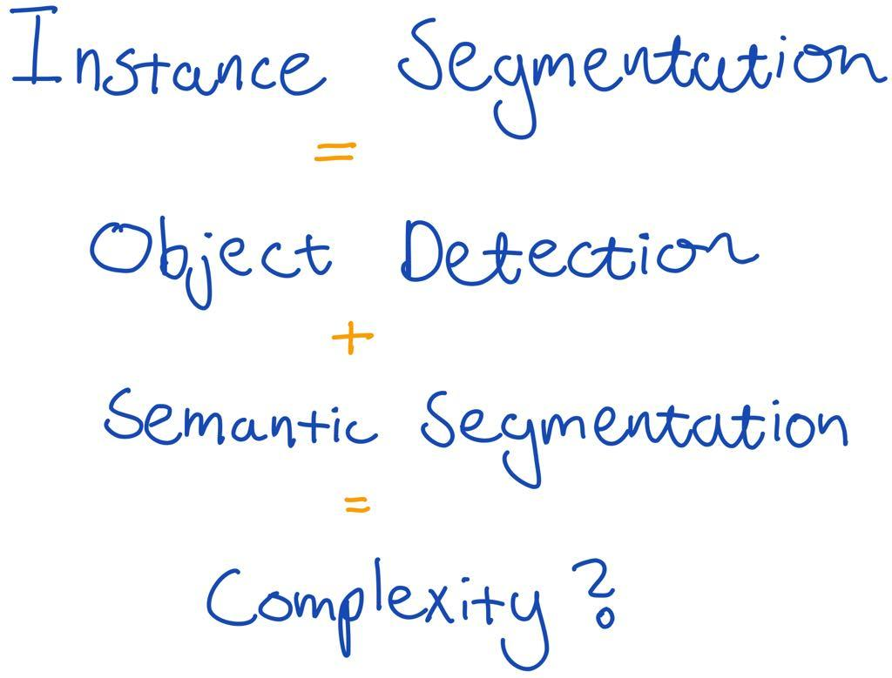
Problem Complexity

Slide 4
“[...] one might expect a complex method is required to achieve good results. However, we show that a surprisingly simple, flexible, and fast system can surpass prior state-of-the-art instance segmentation results.”

Slide 5
Starting Point
Extending Fast R-CNN in order to predict a segmentation mask

Slide 6
Proposal
Apply a parallel fully convolutional network (FCN) mask branch to each region of interest (RoI)

Slide 7
Problem
RoIPool introduces a misalignment of input vs. output during quantization into spatial bins.
Notes:
Quantization happens during mapping to the discrete granularity of the feature map and during the subdivision into spatial bins.

Slide 8
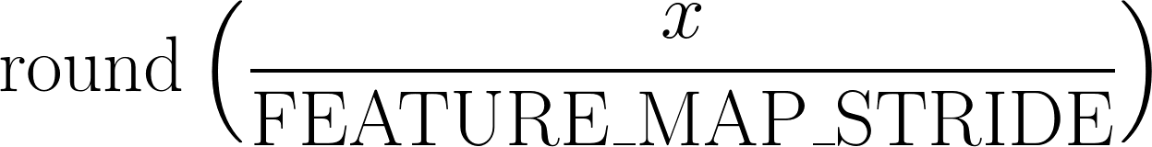
RoIPool Quantization
RoIPool quantizes a continuous coordinate x by computing:
Notes:
Likewise for separation into spatial bins. Feature map stride = 16, spatial bins = 7 * 7. Okay for classification, which is robust to small translations, but it has a large negative effect on predicting pixel-accurate masks.

Slide 9
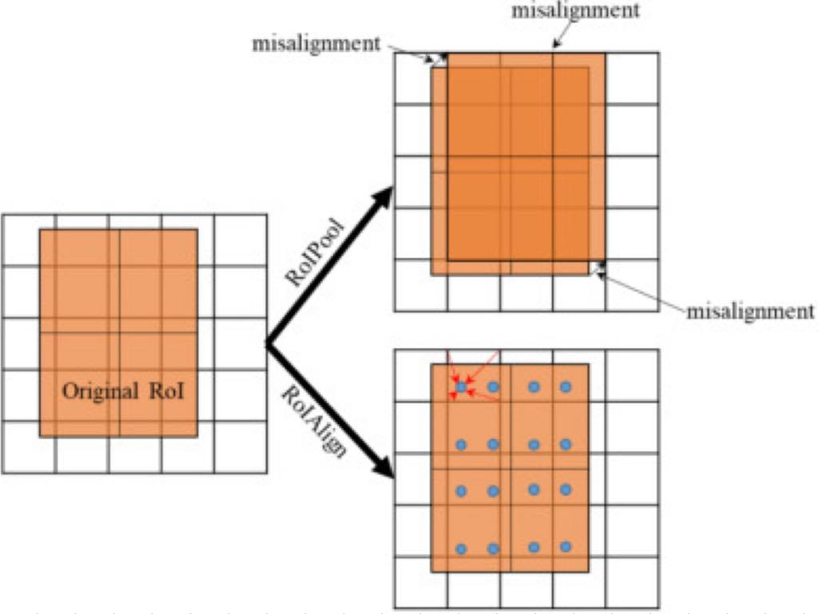
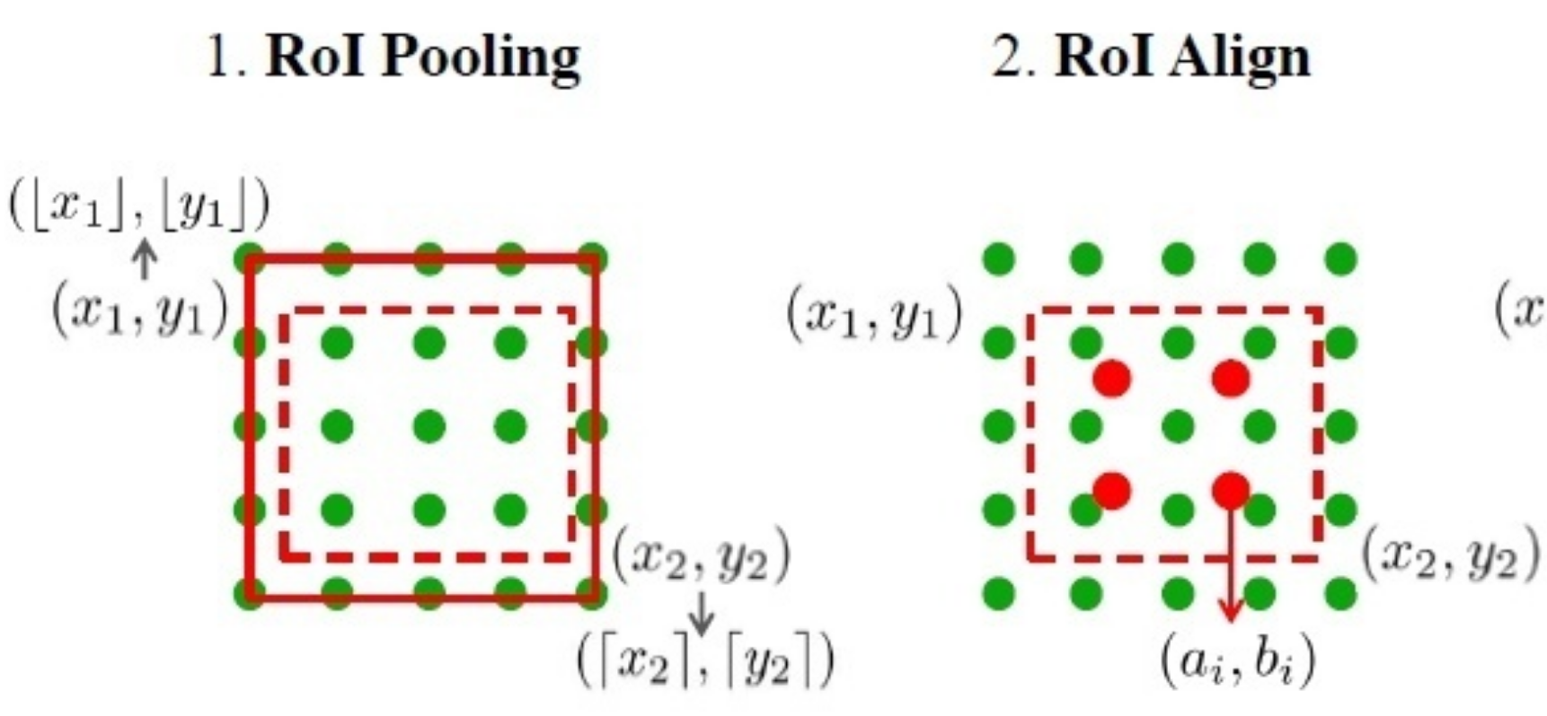
Solution - Bilinear Interpolation

Slide 10
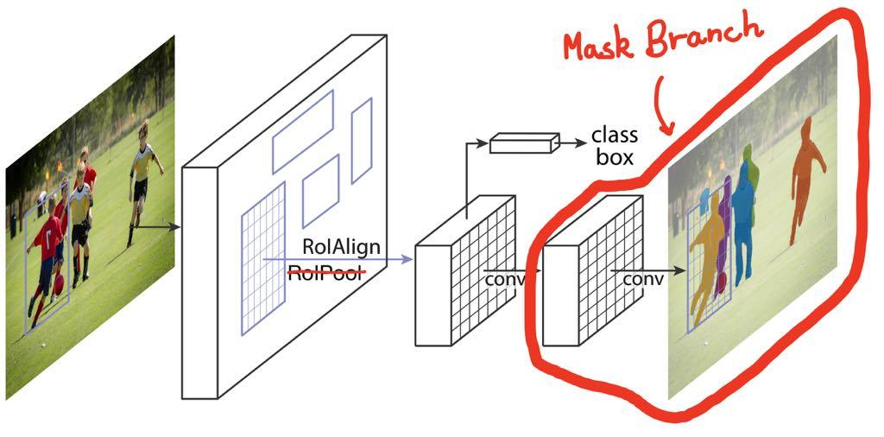
RoIPool → RoIAlign
“[...] RoIAlign has a large impact: it improves mask accuracy by relative 10% to 50%, showing bigger gains under stricter localization metrics.”

Slide 11
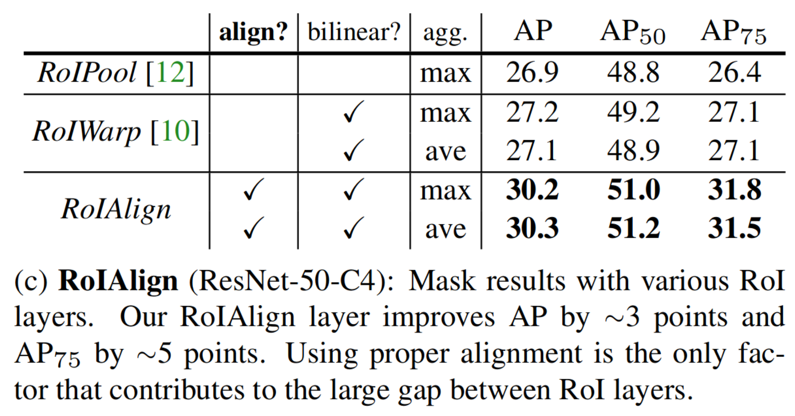

Slide 12
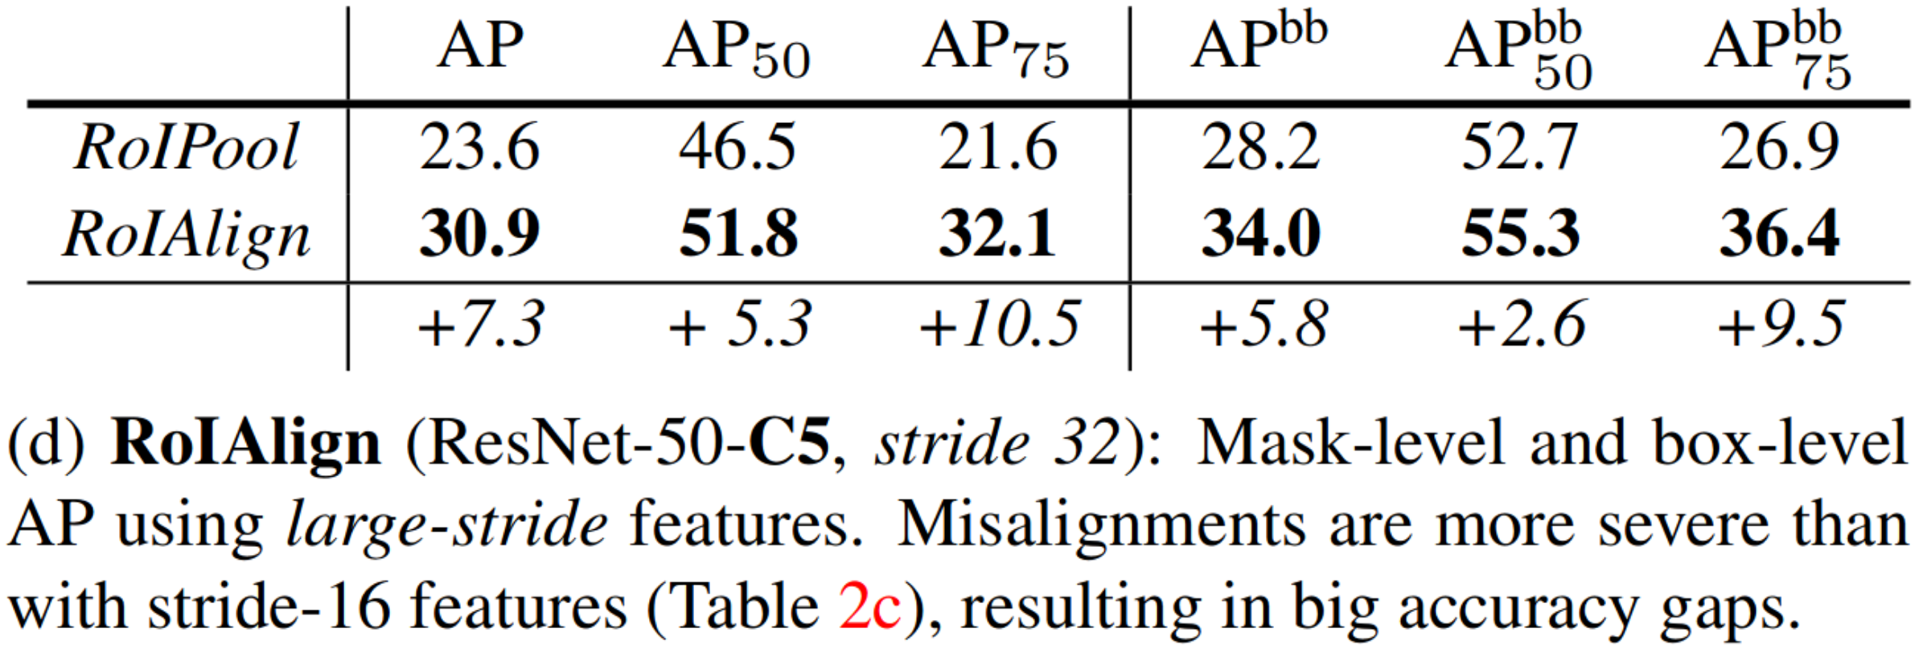

Slide 13
Decoupling Segmentation and Class Prediction
Normal FCN approach - Per-pixel multi-class categorization
Segmentation precedes recognition, which is slow and less accurate
Loss: Per-pixel softmax and a multinomial cross-entropy loss
“[...] based on our experiments works poorly for instance segmentation”
Mask R-CNN - Independent binary mask for each class
No class competition
RoI classification branch responsible for predicting the class of each pixel
Parallel prediction of masks and class labels, which is simpler and more flexible
Loss: Per-pixel sigmoid and a binary loss

Slide 14
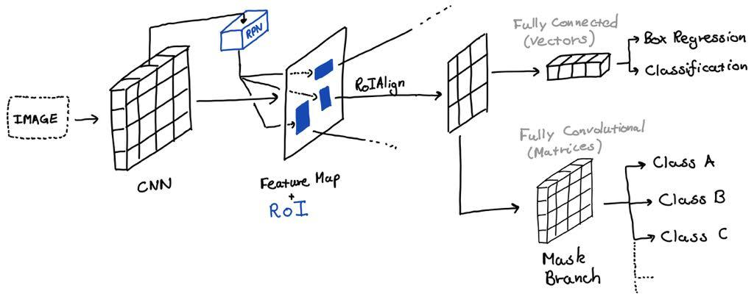

Slide 15
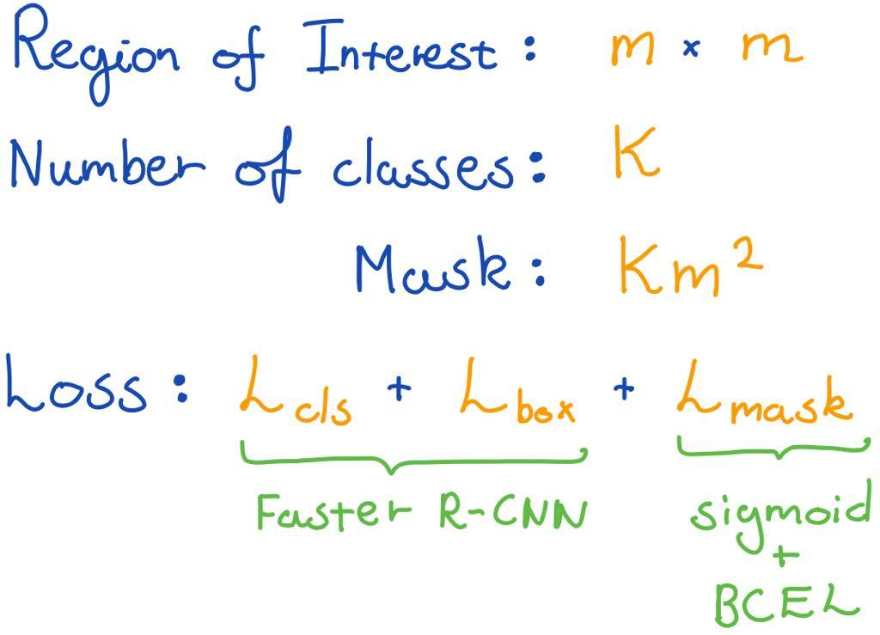
Binary Masks

Slide 16
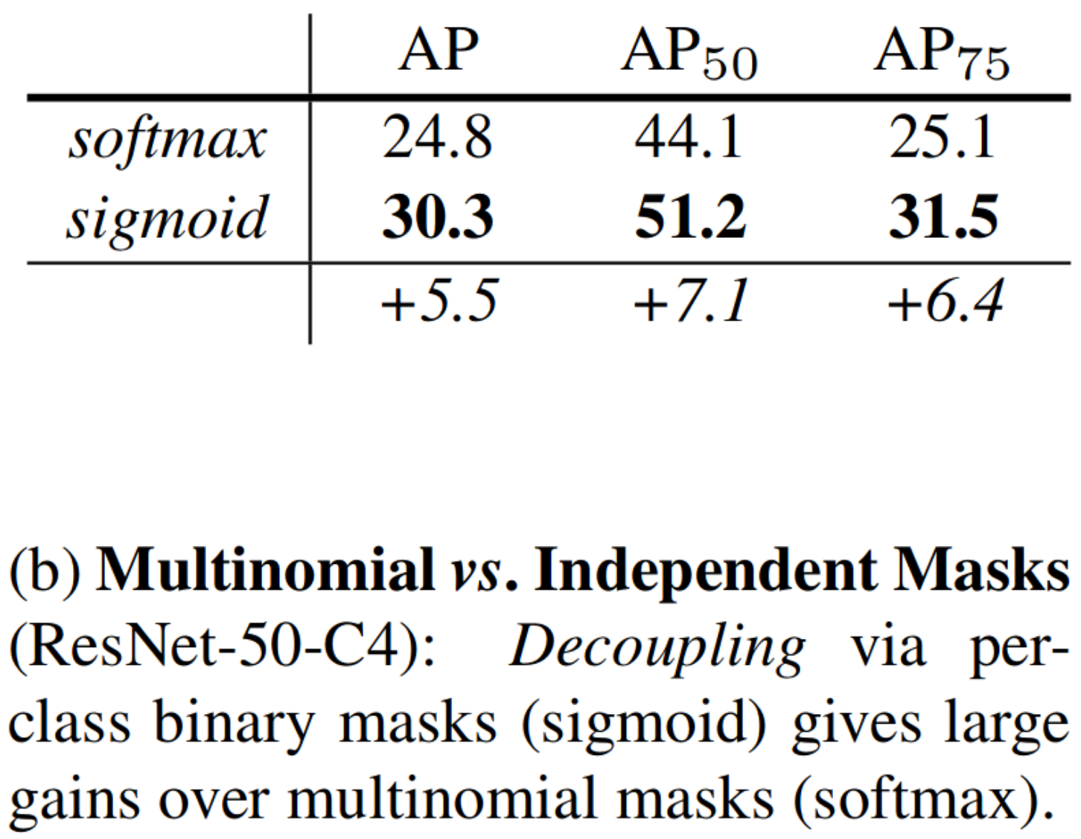

Slide 17
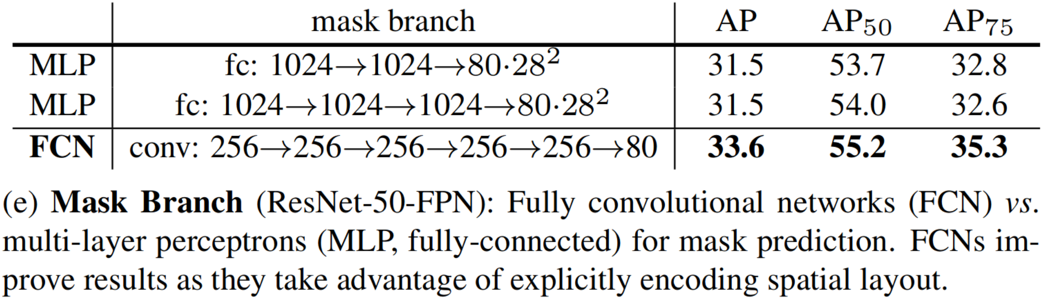

Slide 18
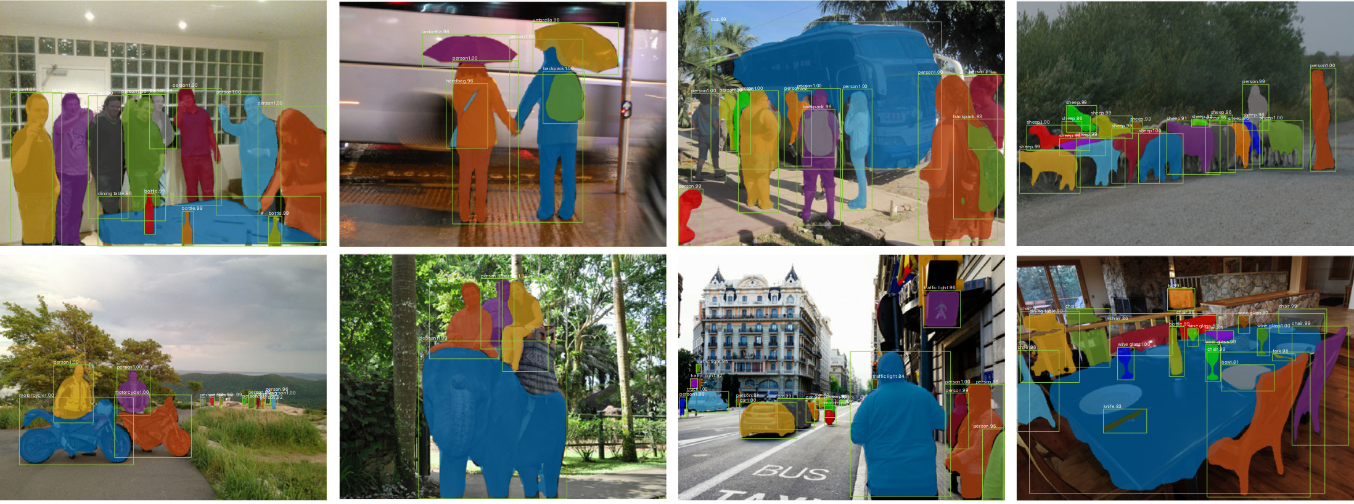
Results

Slide 19
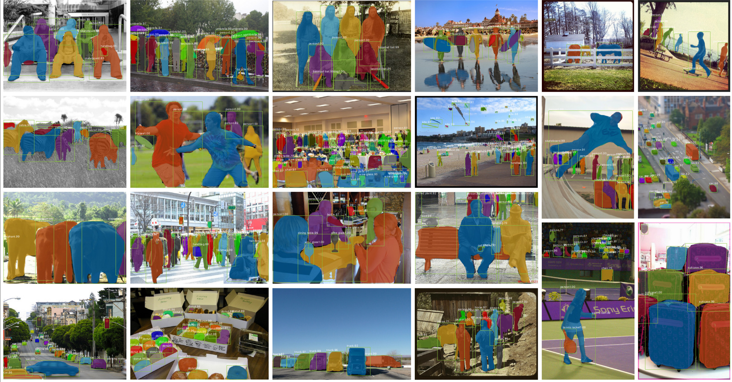

Slide 20
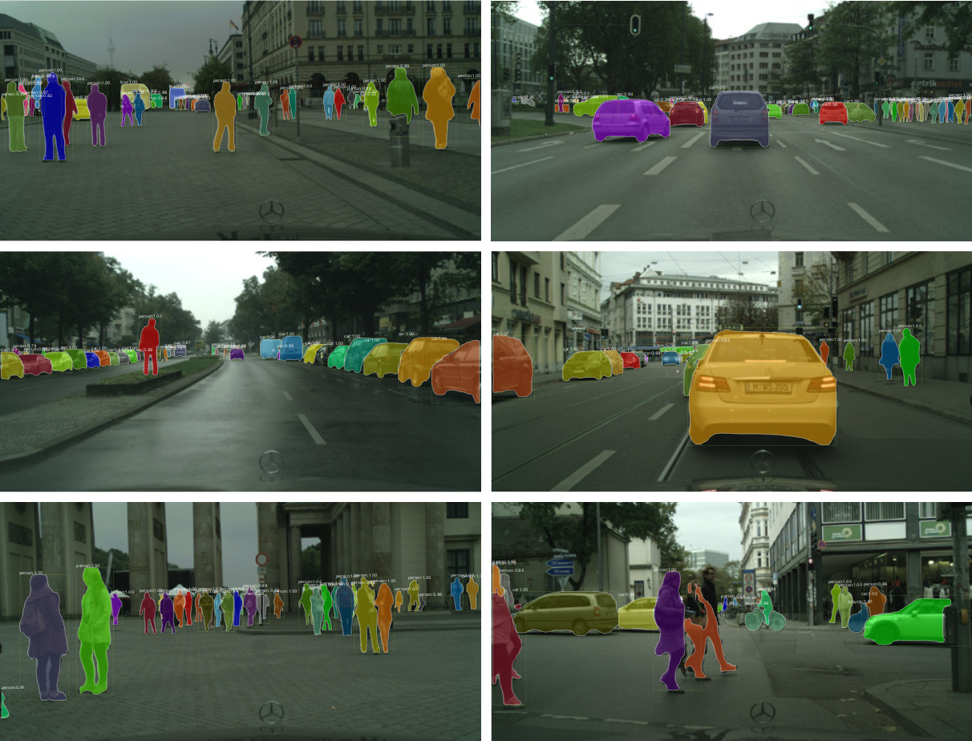
Generalizes to CityScapes

Slide 21
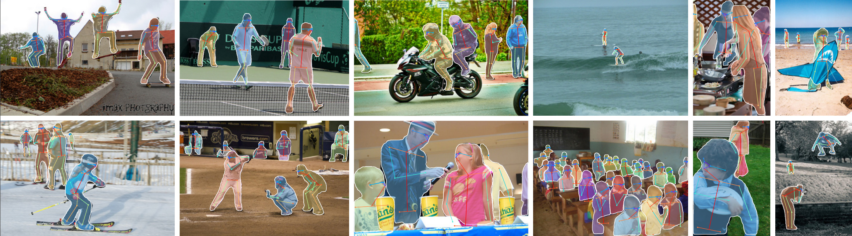
Generalizes to Keypoint Detection

Slide 22
Comparison with FCIS+++
Position-sensitive output channels by full convolution
Channels are responsible for (no decoupling):
Object classification
Bounding box regression
Segmentation masks
Fast but systematic errors on overlapping instances and spurious edges

Slide 23
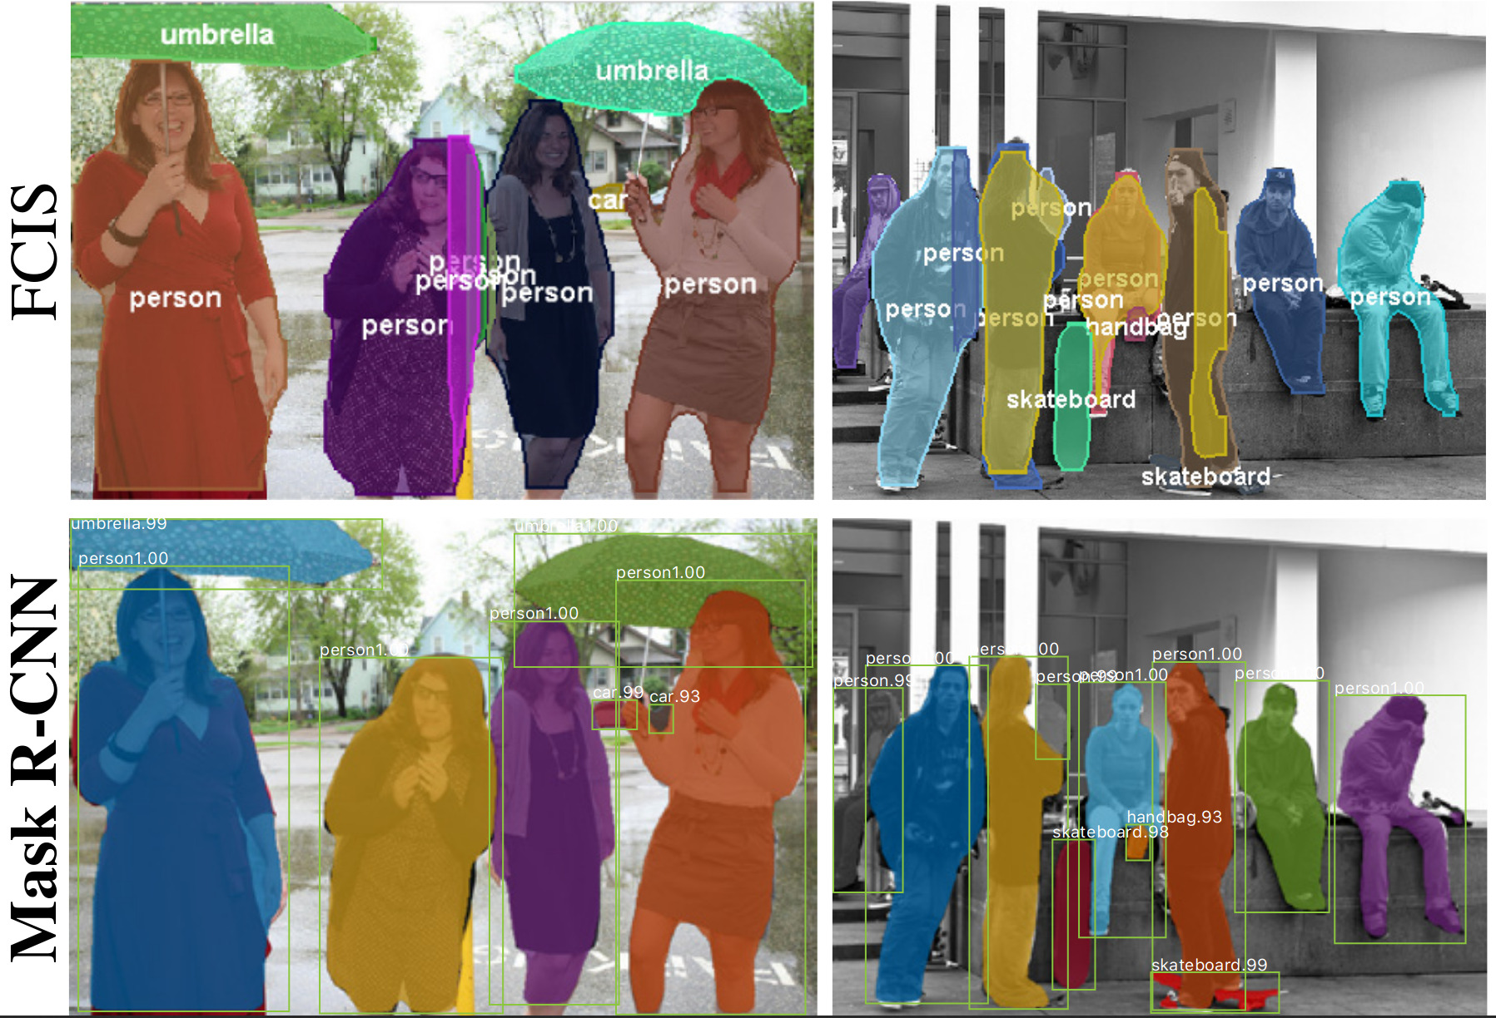

Slide 24
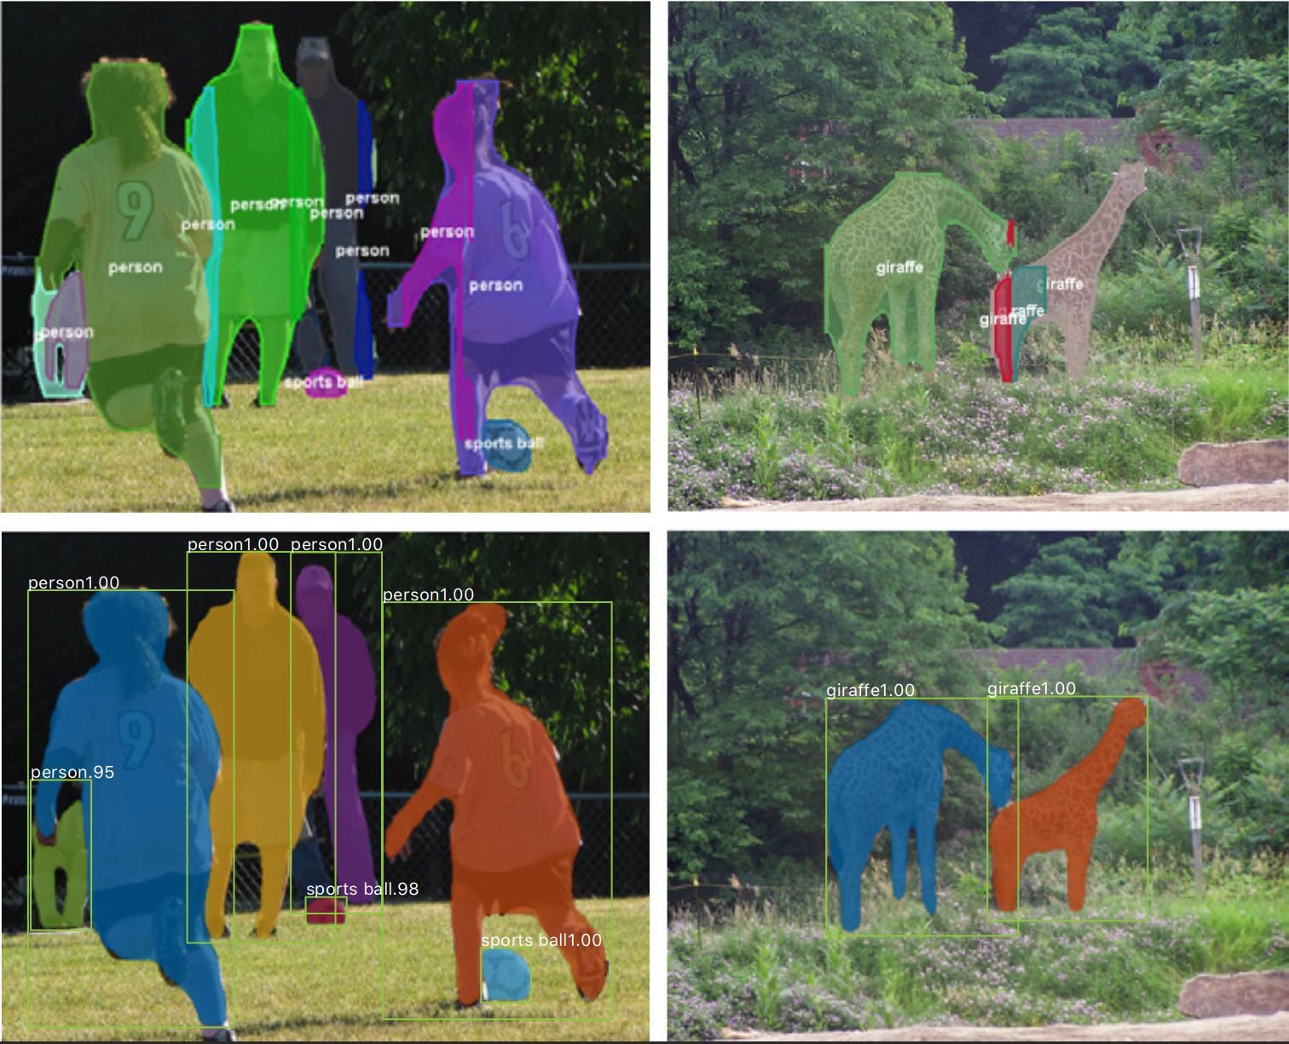

Slide 25
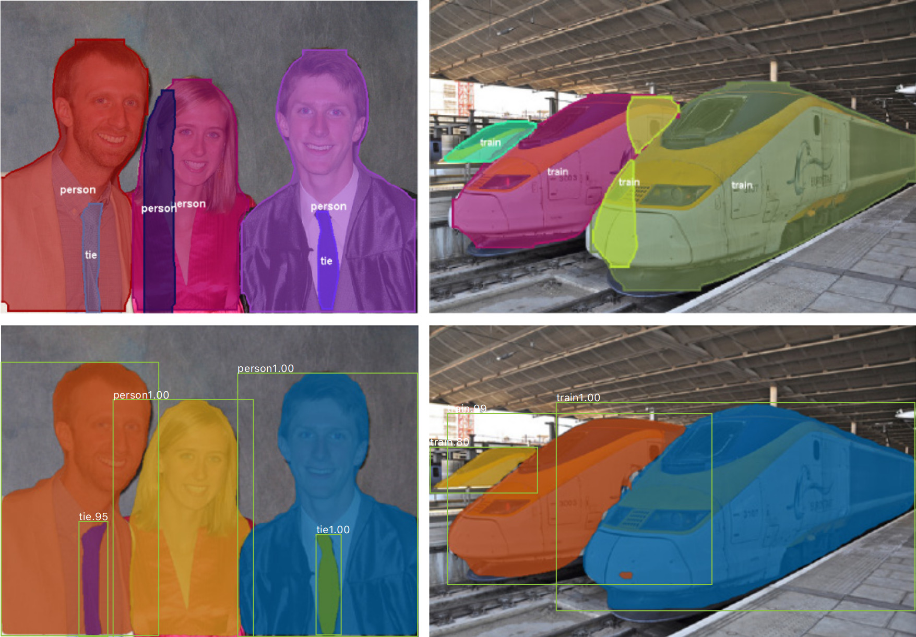

Slide 26
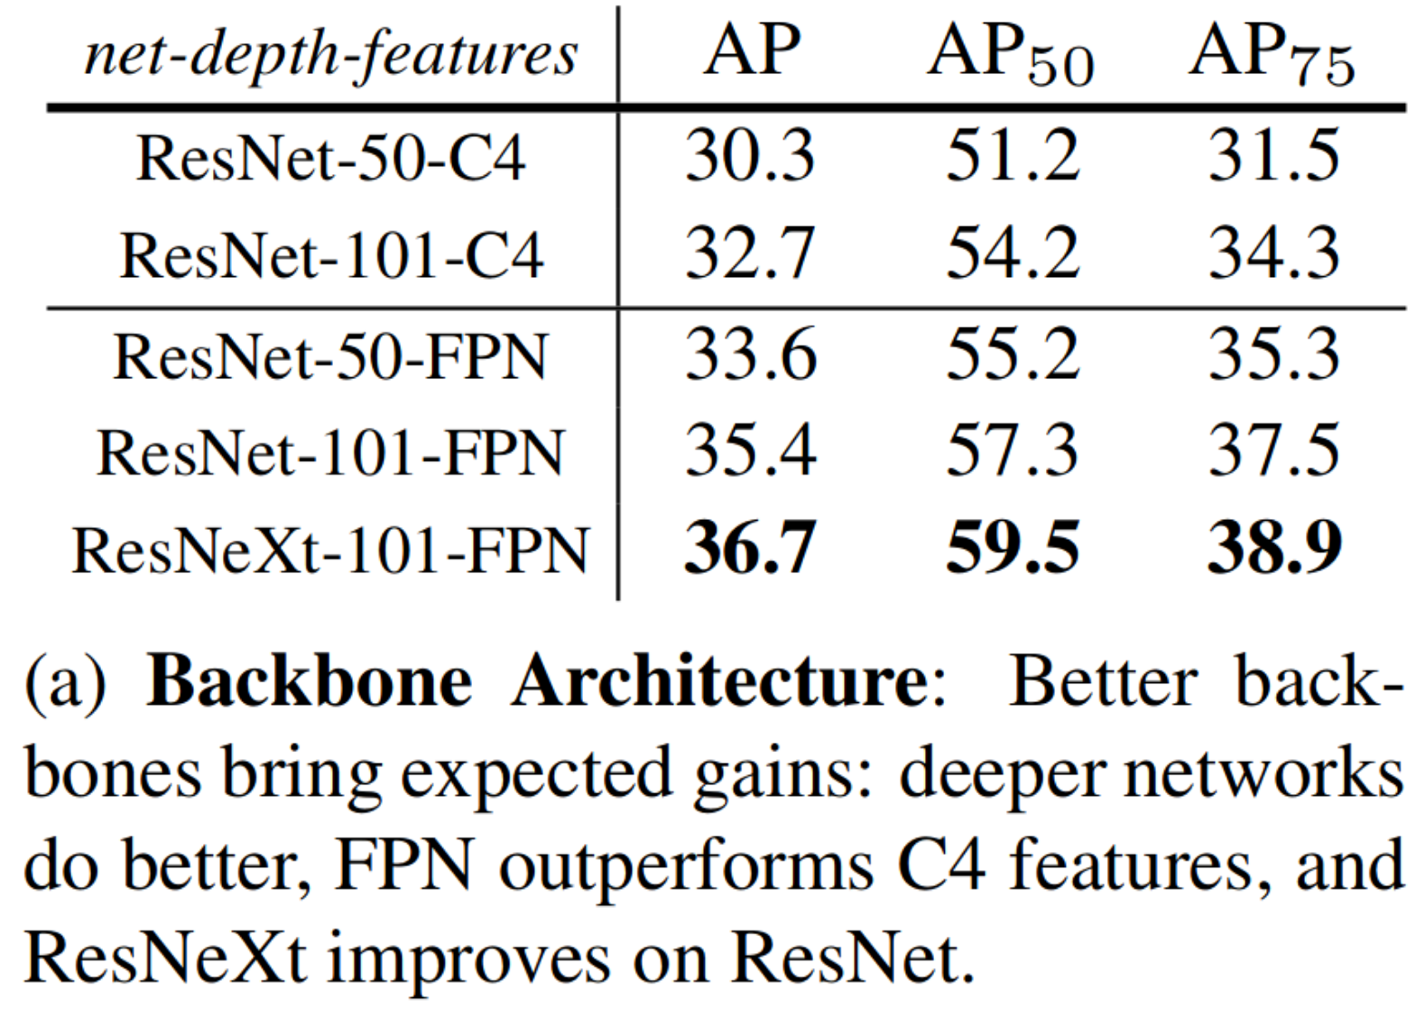
Benefits from Deeper Networks

Slide 27
Accolades
Outperformed every single-model entry on every task in the COCO 2017 Challenge at time of publication in March
Instance segmentation
Bounding-box object detection
Person keypoint detection
FAIR still won “COCO Stuff” competition at the end of 2017
Won “ICCV 2017 Best Paper Award”

Slide 28
Key Contributions
RoI alignment Preservation of pixel alignment in order to predict pixel-accurate segmentation masks.
Independent masks Decouples mask and class prediction. Mask branch segments independently for each class, while box branch decides on final labels. Negligible computational overhead and less complexity.
Use FCN and not FC layers in mask branch Using fully convolutional network in mask prediction captures spatial information.
Class-agnostic masks A single binary mask regardless of class can be nearly as effective provided proper division of labor.

